Slide 1

Data Science Engineering Methods
RAIN IN AUSTRALIA
Ashay Kanade 001548347
Akshay Bhosle 001001091
Shubhankar Salvi 001541699

Slide 2
Problem Statement
The Australian Continent is known for it’s beautiful beaches, diverse flora and fauna, and natural wonders like the Great Barrier Reef, among others. But a lot of people do not know about the tumultuous topography and jagged landforms, which make it extremely hard to define seasons and predict the weather, especially rainfall.

Slide 3
Introduction
Australia’s exceptional aridity is the result of a unique combination of factors. Cold ocean currents off the west coast means there is little evaporation to form rain clouds, while the Great Dividing Range that runs down Australia’s east coast prevents rain from penetrating far inland. There are few mountains to force air upwards where it can cool into rain, and the region is dominated by the subtropical high-pressure belt that both warms and dries the air. What’s more, the continent is extremely susceptible to the El Niño–Southern Oscillation, a heating or cooling of the Pacific Ocean that can bring prolonged periods of high temperatures and drought.
We will try to answer the question of whether or not it will rain tomorrow in Australia. We implemented kNN, Decision tree, Random Forest with Python and Scikit-Learn.
We have used the Rain in Australia dataset for this project.

Slide 4
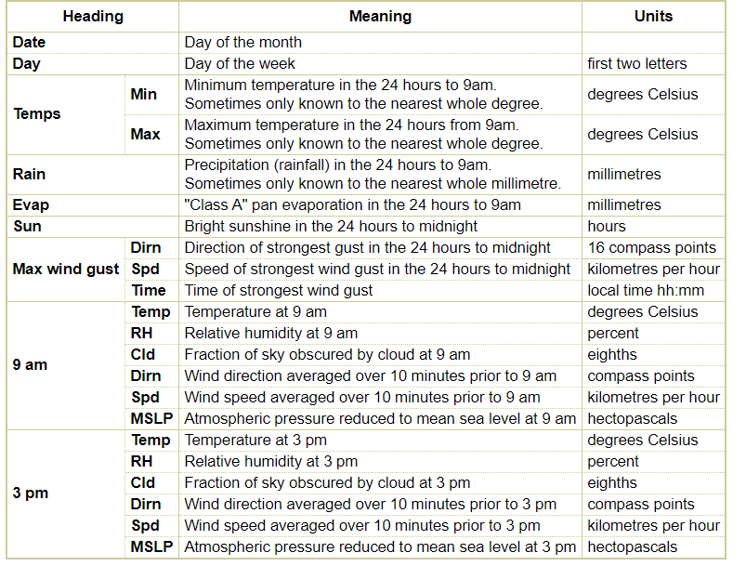
The Dataset – Rain in Australia
This dataset contains about 10 years of daily weather observations from many locations across Australia. RainTomorrow is the target variable to predict. It means -- did it rain the next day, Yes or No?
This column is Yes if the rain for that day was 1mm or more.

Slide 5
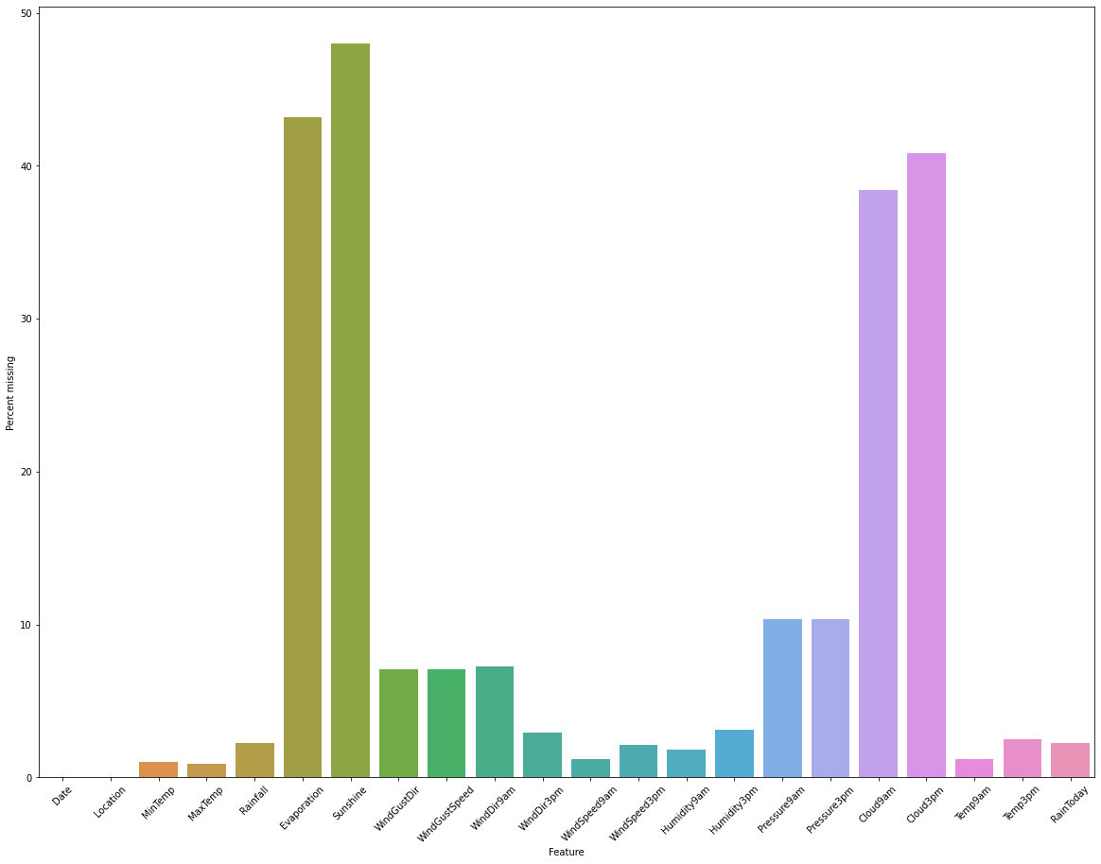
Preprocessing the Dataset – Our Approach
We have taken the following steps for preprocessing on our selected dataset :-
1. Finding Missing Values:
We have used mode values to impute categorical variables, and for numeric variables, we have used simple imputers, iterative imputation as well as knn imputation to fill in the missing values.
2. Finding Outliers:
Firstly we used the Describe() function to find variables where we were able to see the differences in the Quartile Ranges. For finding the appropriate upper value we used Statistical Formula which was : Upper fence = Q3 + (1.5 * IQR) . Using this formula we procured the upper fence values for above mentioned variables. We redefined the maximum values as the upper fence.

Slide 6
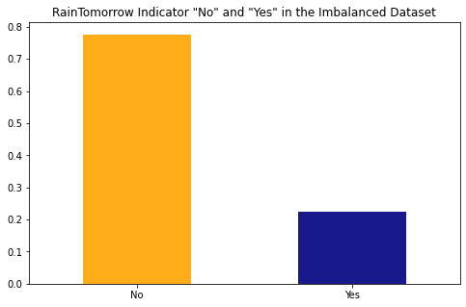
Preprocessing(Contd.)
3. Sampling the Dataset:
We sampled the data set as we found out that the target variable was imbalanced.
4. Dummy Variables:
There were five categorical variables excluding target variables so we decided to make these dummy variable columns. We calculated the frequencies of these categorical variables and introduced them as unique columns in the dataset.
5. Scaling the Dataset:
Differences in the scales across input variables may increase the difficulty of the problem being modeled. So we scaled the dataset to make it more stable and machine friendly to use.

Slide 7
Training Models Used
We have used 4 types of training models namely :
-KNN Model
-DNN Model
-Decision Tree
-Random Forest

Slide 8
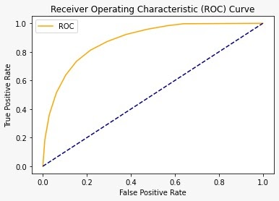
KNN Model and it’s Inference
Even though KNN being the simplest model of them all, it consumed a huge amount of time as well as power. So we would not recommend you to use KNN for such a big dataset.
Accuracy on test set : 79.79%

Slide 9

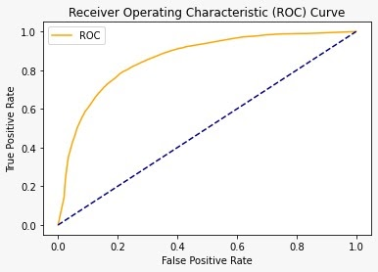
DNN Model and it’s Inference
DNN being one of the most sophisticated of them all, it consumed a lot of computing power even though we executed it on Google Colab.
When the epoch was set for 110 and batch size was 5, we observed that after the 36th epoch the validation accuracy was going below 1% therefore we discontinued the execution.
Then, we tuned the hyperparameter of the epoch and set it to 22 and increased the batch size to 7 which gave us the accuracy 77.55% on the test set.

Slide 10
Decision Tree Model and it’s Inference
We observed that the decision tree was second optimal after random forest with the parameters max_depth = 16 and max_features = sqrt. We achieved an accuracy of 78.67% & 80.63% on two differently imputed test sets.

Slide 11
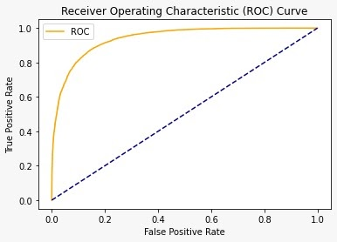
Random Forest Model and it’s Inference
Random forest was the most robust and quickest of them all with the highest accuracy rate of 85.36% and 86.3% on two differently imputed test sets. Using this we were also able to derive important features looking at which we dropped the least important of them and achieved an accuracy of 89.12% with the model which was trained just on most important features.

Slide 12
Conclusion and Future Scope
From the aforementioned results achieved , we conclude that the best results are given by the Random Forest Model with an accuracy going as much as 89.12% when trained on the most important features.
After using above mentioned models we constructed that the humidity, sunshine & cloud covered at 3pm plays an important role for predicting the rainfall in Australia over different regions depending on wind gust speed, evaporation and min/max temperature highly correlating with wind direction.

Slide 13
THANK YOU!

